Slide 1
Wing CAD

Slide 2
Cad instructions
For leading/trailing edge:
Use offset + extrude
For spars:
Make a tube cross section on the first rib and extrude it
Boolean out the middle section
Notes:
Harish

Slide 3
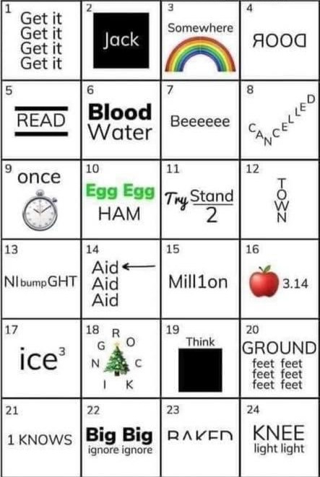
Welcome!
Anyone know the answers?
Airfoil Activity Form
Notes:
Answers: https://puzzleaday.wordpress.com/2020/09/08/24-rebus-puzzles/ ,-Maya

Slide 4
Why do we need to CAD our Wing?
As usual, CAD ( Computer Aided Design ) is mainly used for modeling things that are too hard to make models of in real life
CAD can also be used to *simulate*.
Put forces on our wing to make sure it doesn’t break (this is really important)
Determine materials, thicknesses ( for example, how thick a piece of metal should be

Slide 5
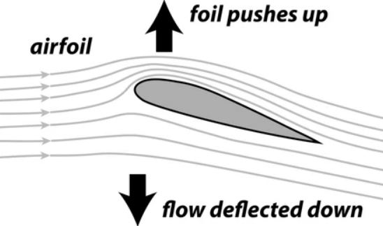
Airfoils: there’s a lot of them
The shape of a wing when you look at its cross section is called an airfoil:
The shape of your airfoil will
Change your lift and drag coefficients, and some airfoils are better than others for specific purposes (eg between a giant commercial jet vs an ultralight
Notes:
Harish

Slide 6
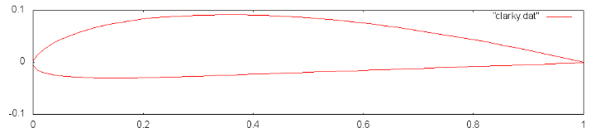
Choose an airfoil
This website, called airfoils tools, Allows you to choose between different standards of airfoils and modify them. We are going to be working with Clark Y.
http://airfoiltools.com/compare/index
Notes:
Maya

Slide 7

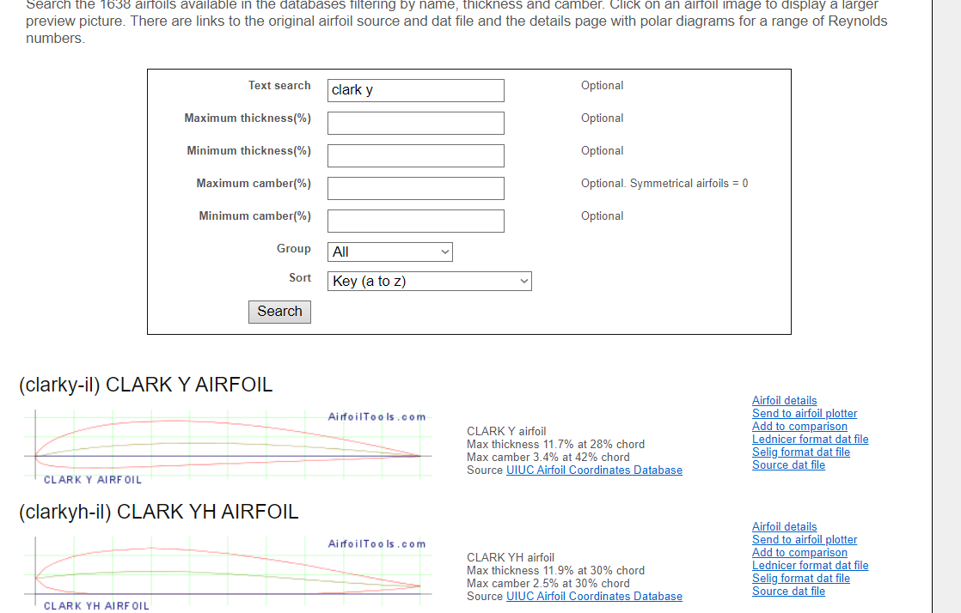
Notes:
Harish

Slide 8
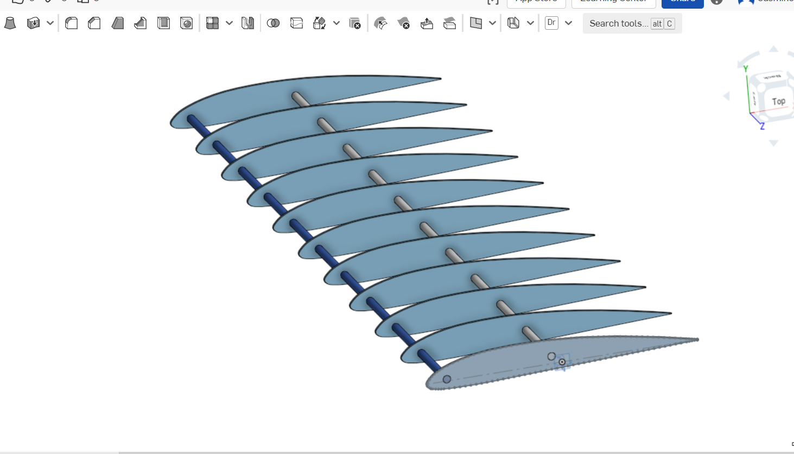
Onshape time!

Slide 9
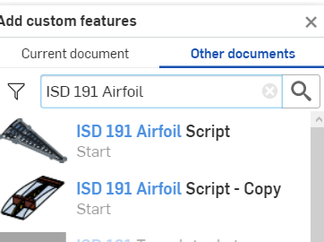

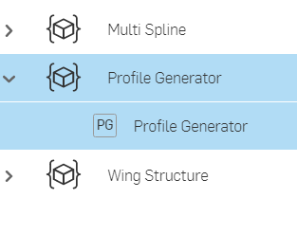
Initial Steps
Open up onshape and create a new Document called “Wing CAD”, and we’re going to be using a plugin that will help us create an airfoil
Click on the plus sign next to the search tools on the top right in the toolbar
Enter “ISD191 Airfoil Script” into the search bar
that pops up
Alternatively, Paste this link into the search bar
( make sure to have the other documents option selected )
Click on it, then open up Profile Generator and click on PG Profile Generator
Notes:
Maya

Slide 10
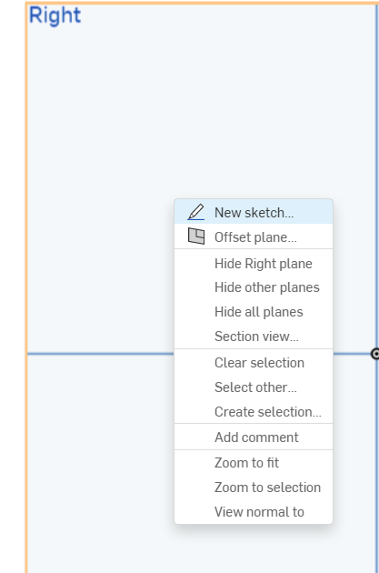
Make a new sketch on the right plane
Notes:
Harish

Slide 11
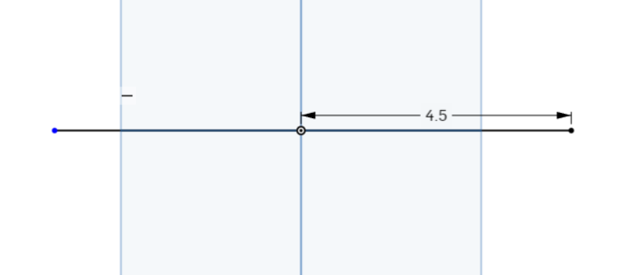
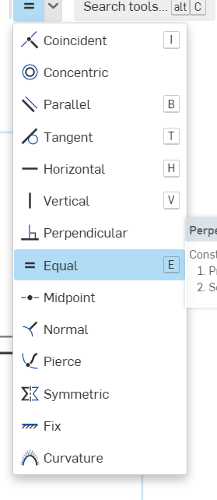
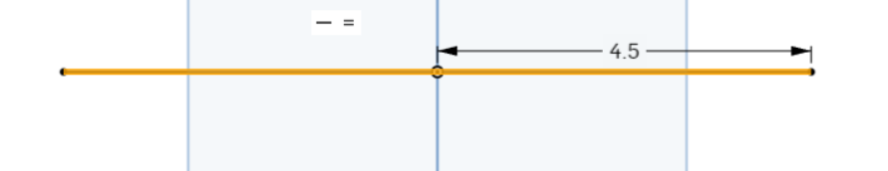
Define the dimensions of the airfoil
For this sketch, we’re going to be using 9 feet as our width, which means that we need a 9 unit long line centered at the origin:
Create a 2 4.5 unit long line
Equal Constraint
Click on both lines to constrain them
When finished, exit sketch
Notes:
Maya

Slide 12
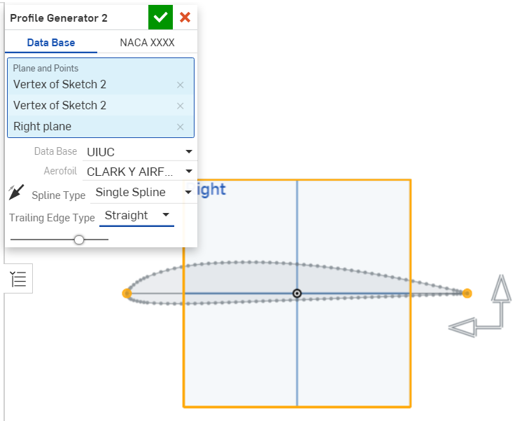
Create a new profile within the sketch, and enter in the required values
Notes:
Harish

Slide 13
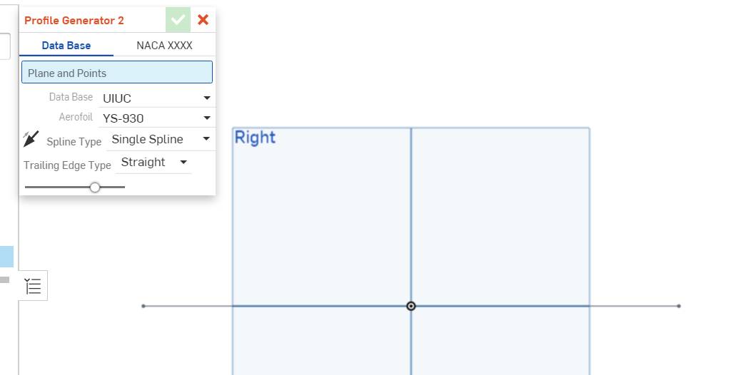
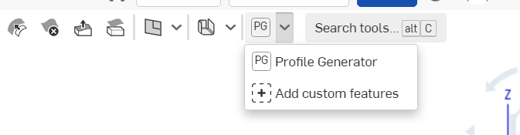
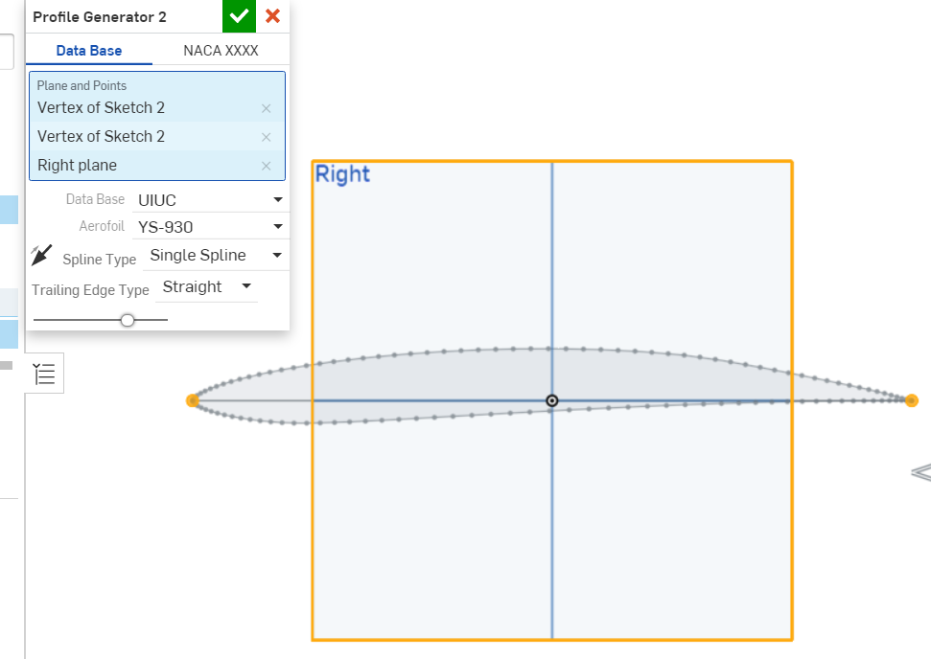
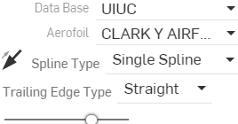
Time to make our airfoil!
You should see this window
Click on pg in the top right, then click on Profile Generator
Click on endpoints of the lines and the right plane
Change the aerofoil to CLARK Y AEROFOIL
Notes:
Maya

Slide 14
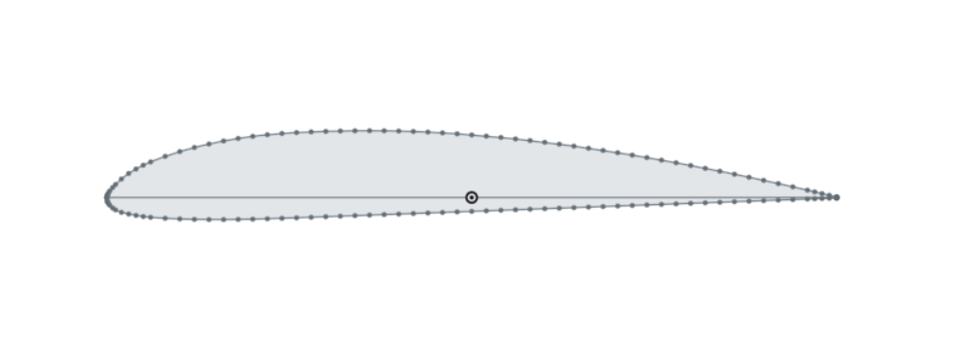
BOOM! You have a very nice looking airfoil!
Notes:
Harsih

Slide 15
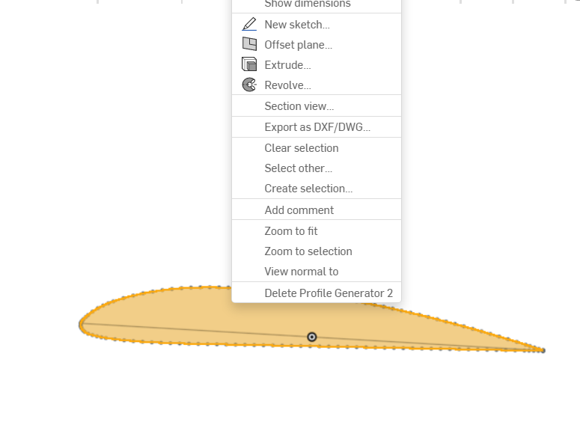
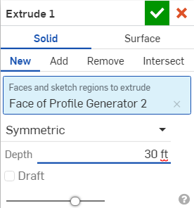
Extrude!
Make it a symmetric extrude (change it from blind), and for now we will be making it 30 ft. wide
Click on the face and extrude it
Notes:
Harish

Slide 16
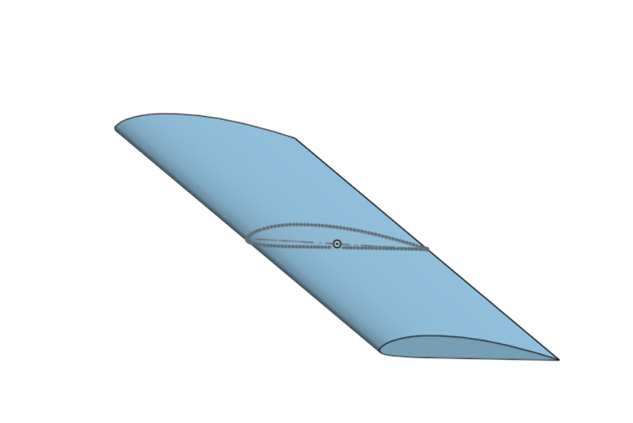
Notes:
Maya

Slide 17
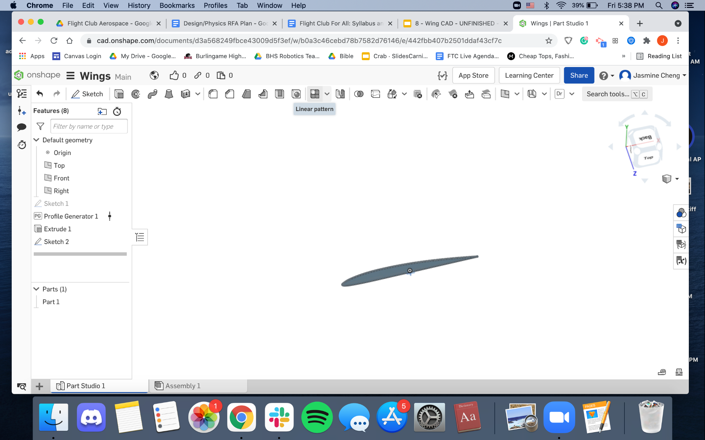
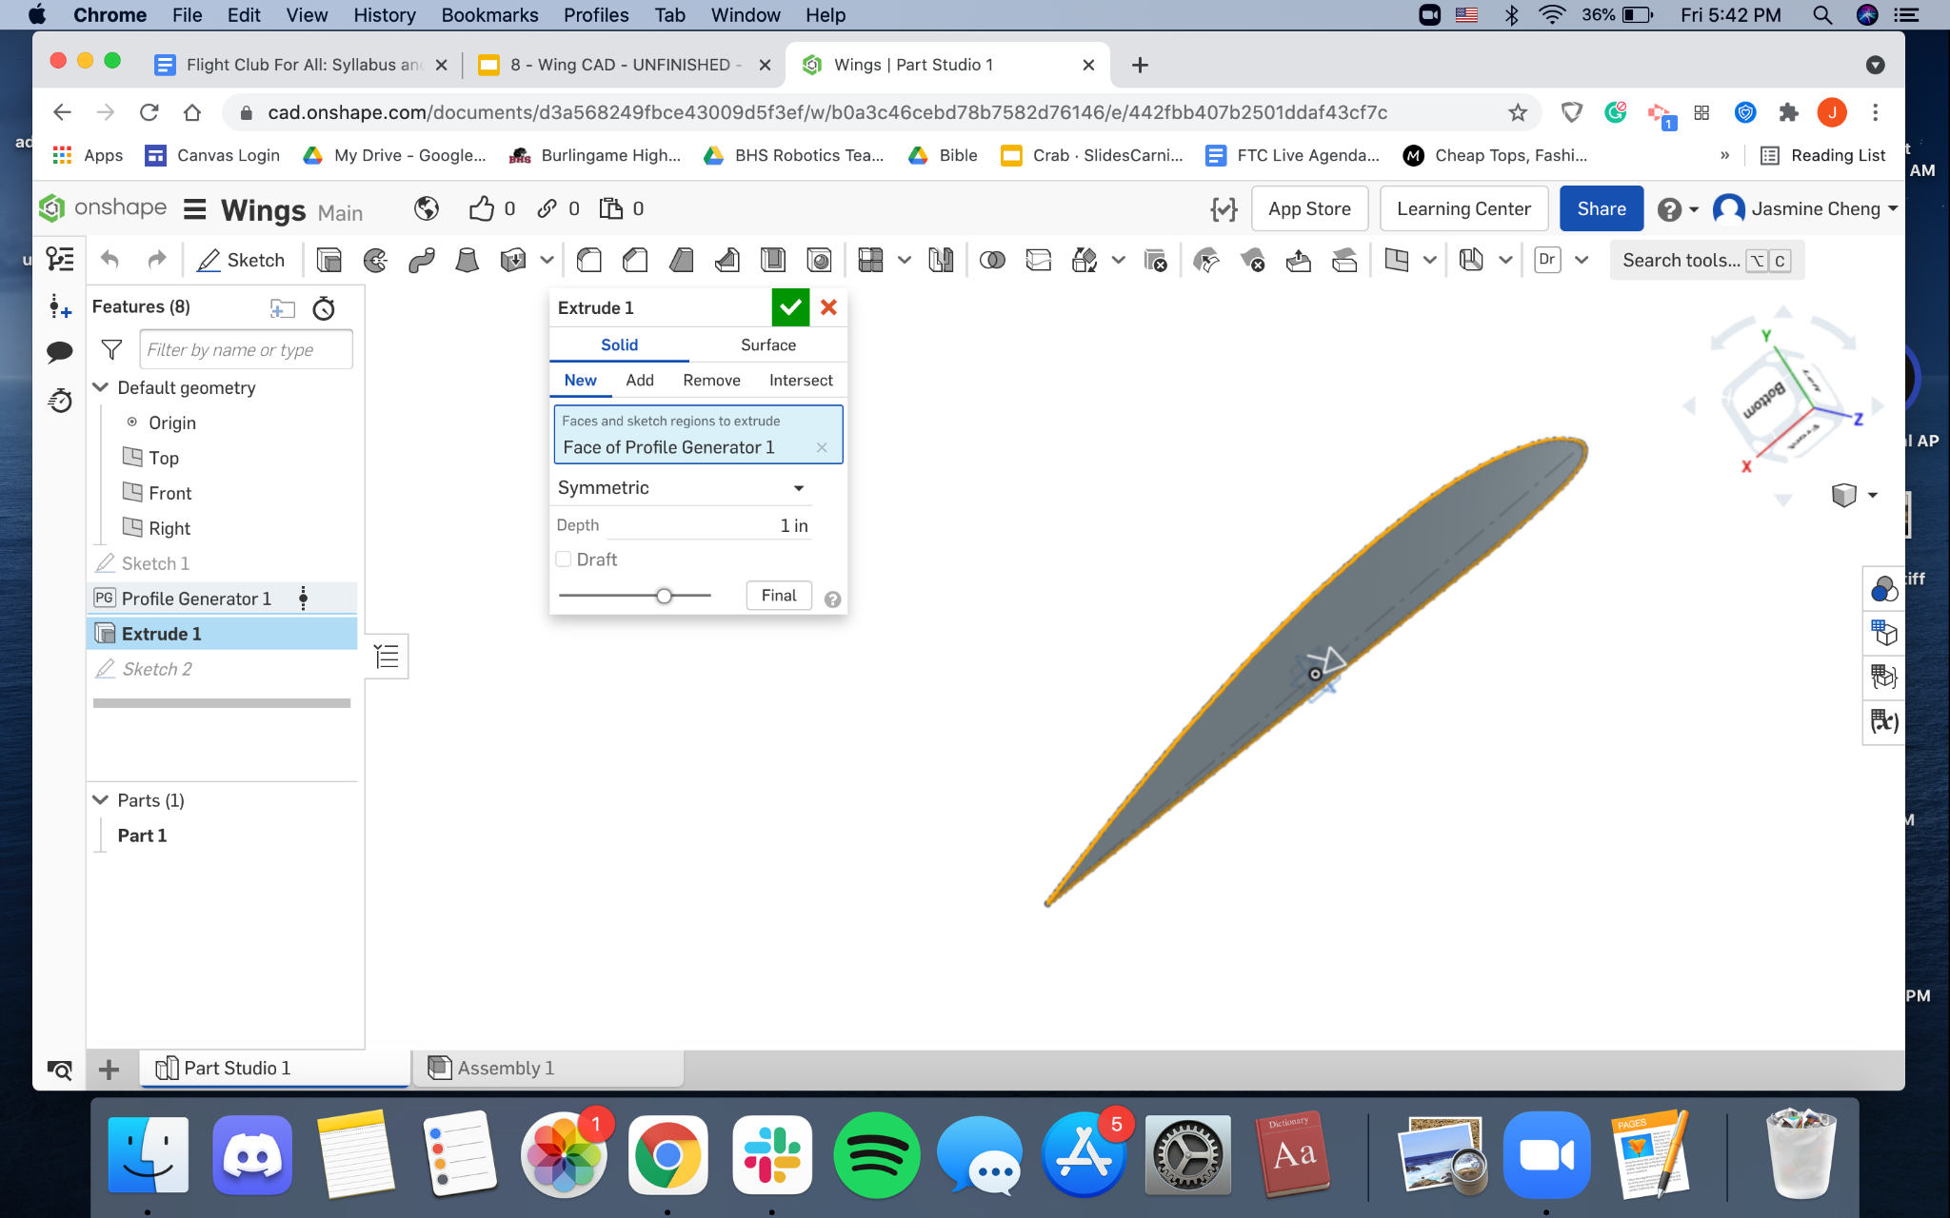
Adding Ribs
Edit (right click on “Extrude 1”) your extrude so it is 1 inch in depth rather than 30 ft. The 30 ft. was for us to visualize how the general wing should be shaped
Let’s now make a linear pattern by clicking on this button.
Notes:
Harish

Slide 18
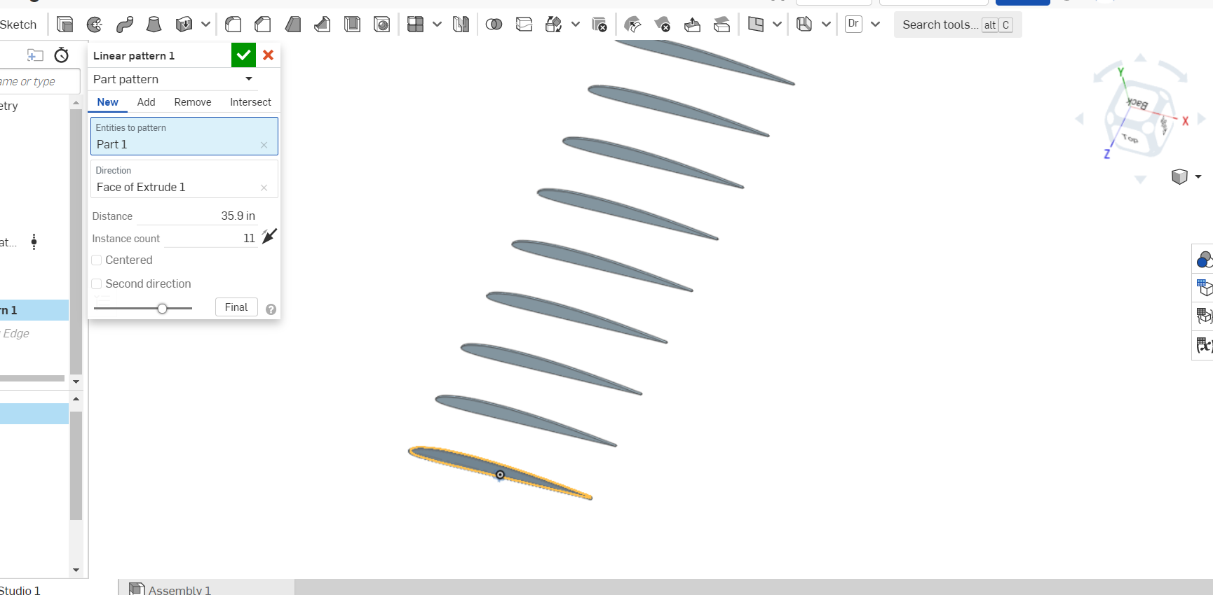
Adding Ribs pt. 2
If we want 10 total ribs, each rib being 1 inch, the distance will be 35.9. Why is this? Keep in mind that the distance is acquired from the front of the first rib to the front of the 2nd rib. Equation is 10x+1=360
Notes:
Maya

Slide 19
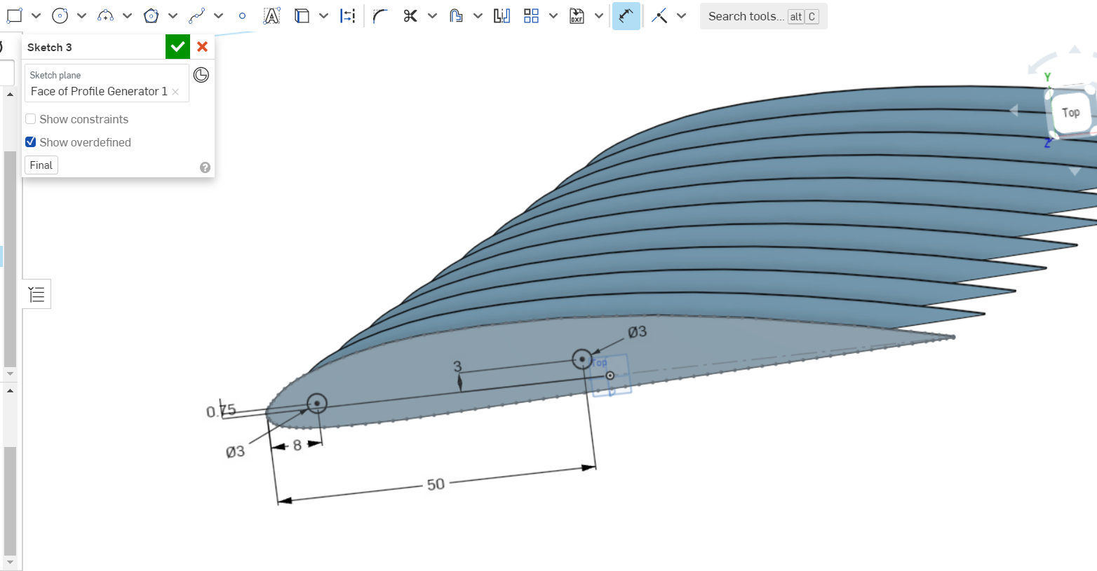
Spars
Make a new sketch on the face of your airfoil. Click “sketch” and click on the face of your airfoil. Click on the circle feature and make a circle. Make the diameter of the circle 3in, distance from the line of the airfoil .75in, and distance from the side/edge of the airfoil 8in.
Make another circle that is 3in from the dotted line, and 50in away from the point on the edge. The circle should be 3in in diameter.
Notes:
Harish

Slide 20
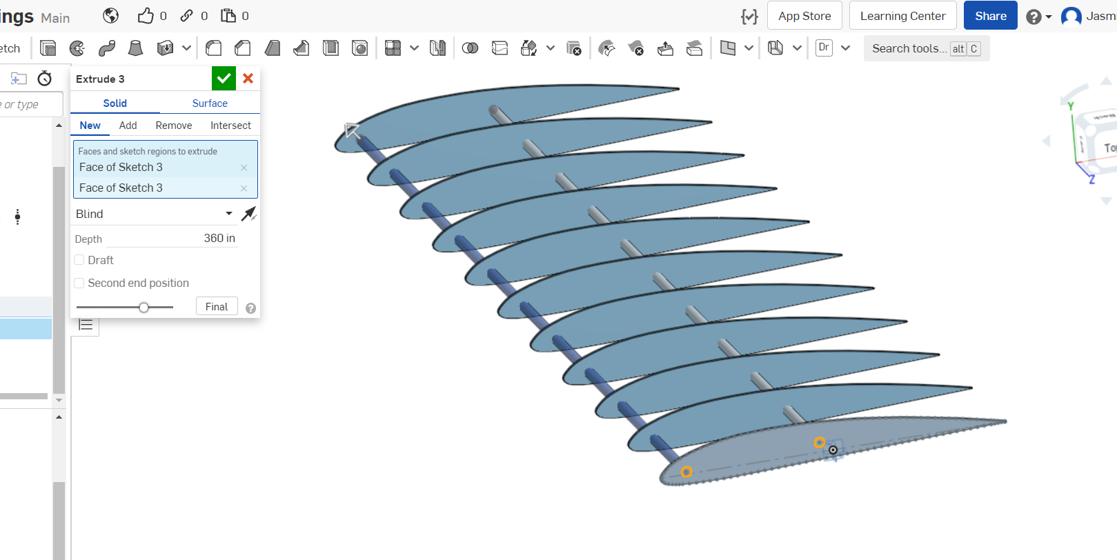
Spars pt. 2
Extrude the sketch to be 360 inches in depth (length). (Make sure you select both circles)
Notes:
Maya

Slide 21
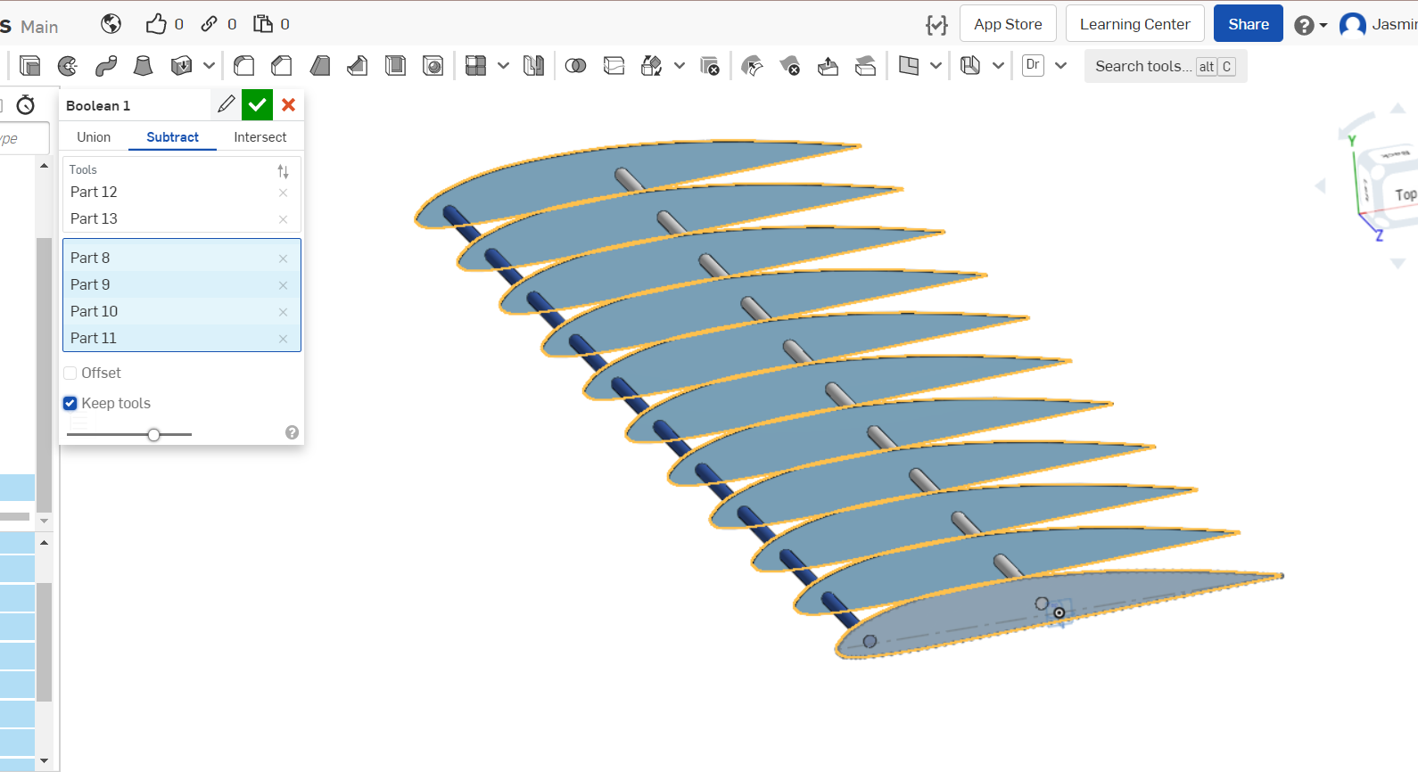
Spars pt. 3
Notice how the spar intersect + faze in and out of the ribs. To this this, click on “boolean” (symbol with two circles at the toolbar) and make sure you are on the subtract tab. This means we would subtract the sections that intersect from the ribs. Your tool is the spar, while your targets should be all the ribs. Make sure that “Keep Tools” is checked!!
Your spar is now finished!
Notes:
Harish

Slide 22
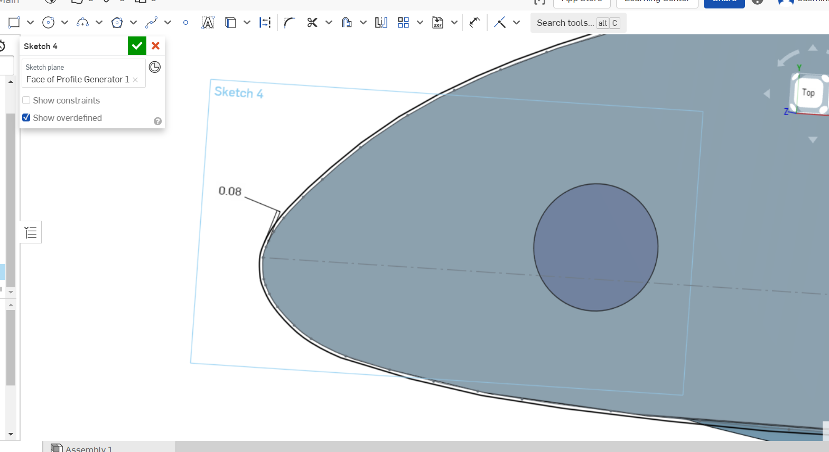
Leading Edge
Make a new sketch on the face of the 1st rib. This time, use the “offset” feature from the toolbar and select the outline of the airfoil. Dimension the distance from the outline and the airfoil to be .08 in, as that’s how thick we want our leading edge to be.
Notes:
Maya

Slide 23
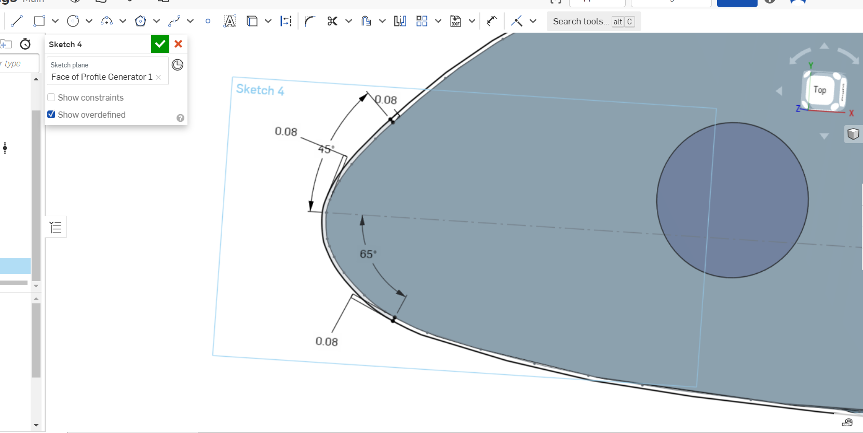
Leading Edge pt. 2
We don’t want to extrude yet because we want to only extrude the edge. Use the line feature to make your section
Make sure both points of the line are coincident to the offset outline and your airfoil, and make sure the line is .08 long.
Select the dimension tool. Click on the top line and click on the dotted line, and make the angle 45 degrees. Now click on the bottom line and the dotted line, and dimension it to be 65 degrees.
Notes:
Harish

Slide 24
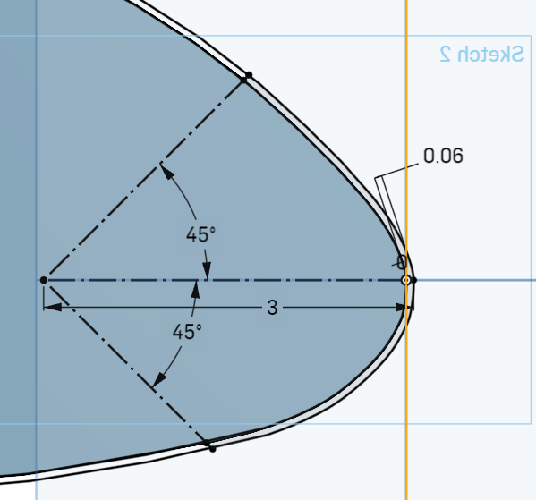

Slide 25
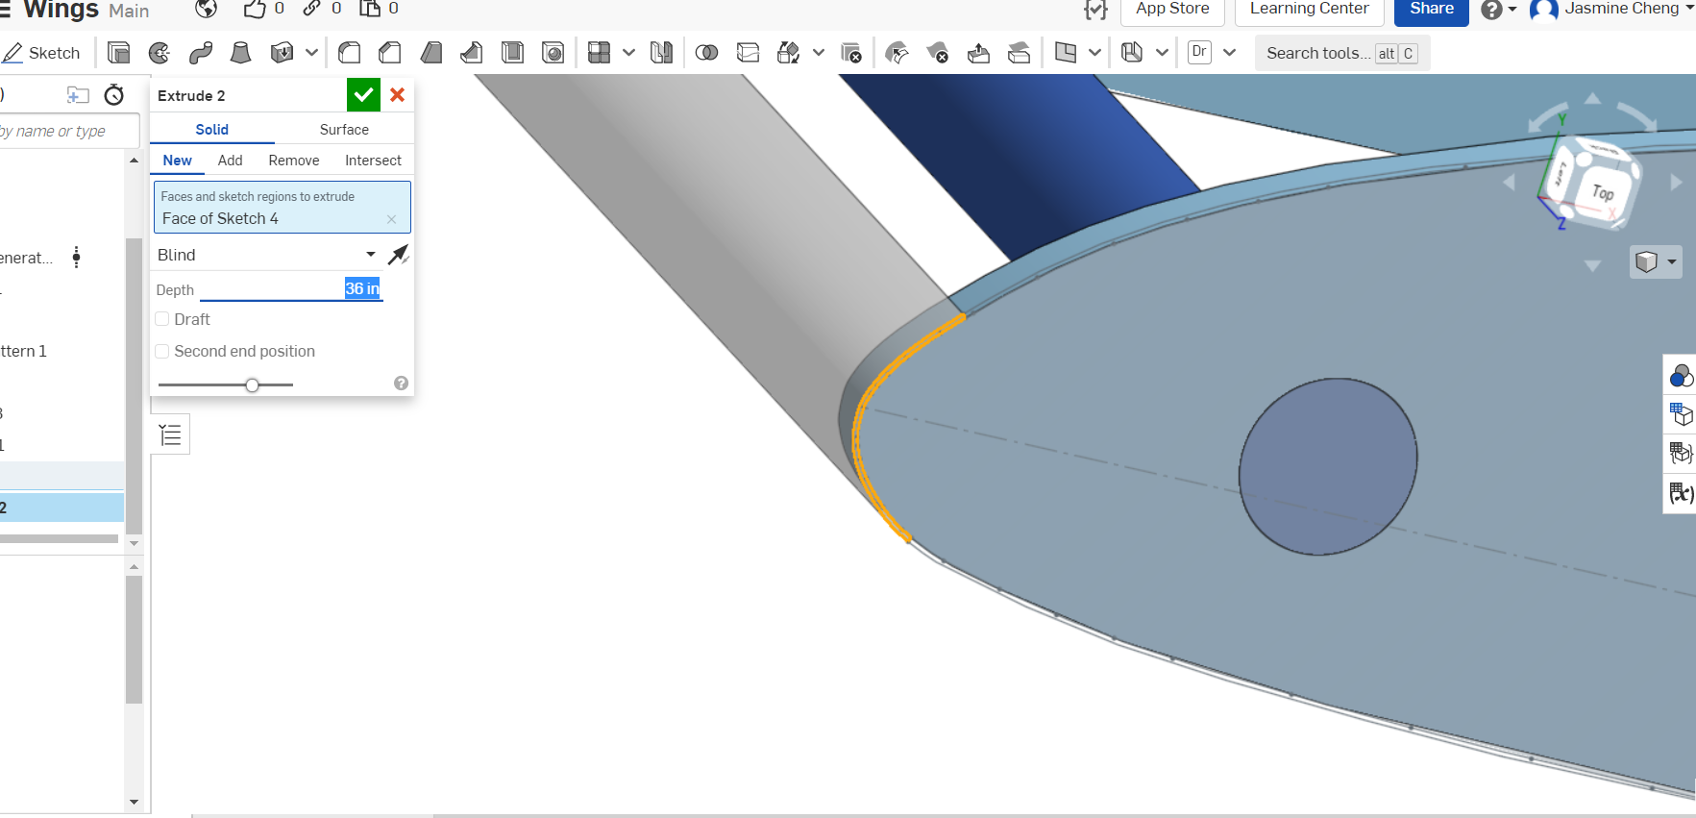
Leading Edge pt. 3
Now extrude it, but make sure you only select the smaller section. Make it 360in.
Notes:
Maya

Slide 26
Feedback Form

